Slide 2
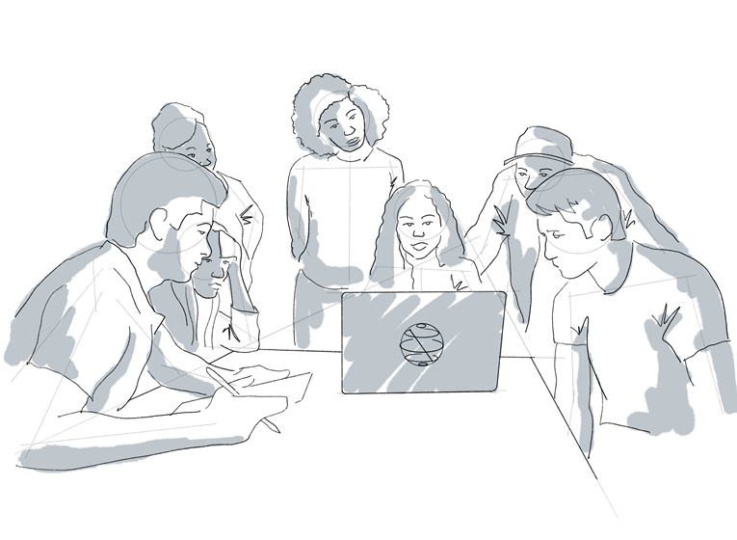


QickStart

Slide 3

Notes:
Let’s start with the classic fable about the power of exponential growth. The creator of the game of chess brought the chess board to the emperor.
The emperor said I love this game! What can I give you as a reward?
The inventor thought for a minute and said “Just rice, your highness. There are only 64 squares on the chess board. You can give me one grain of rice today, and then double it each day after that, for 64 total days.”
The emperor said “what a modest request for a prize” and granted him one grain of rice.

Slide 4
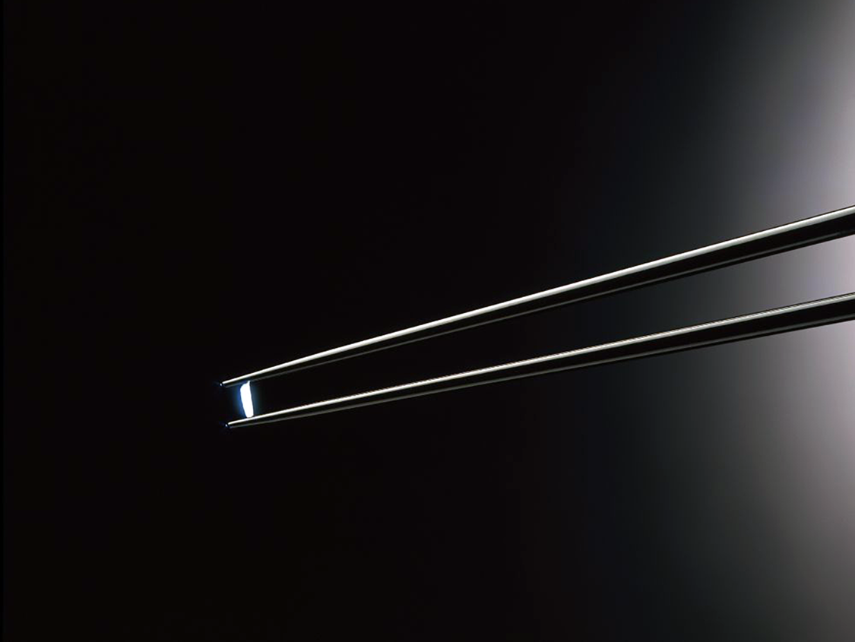
1 day:
A single grain of rice
Notes:
The inventor went home with a single grain of rice that day.

Slide 5
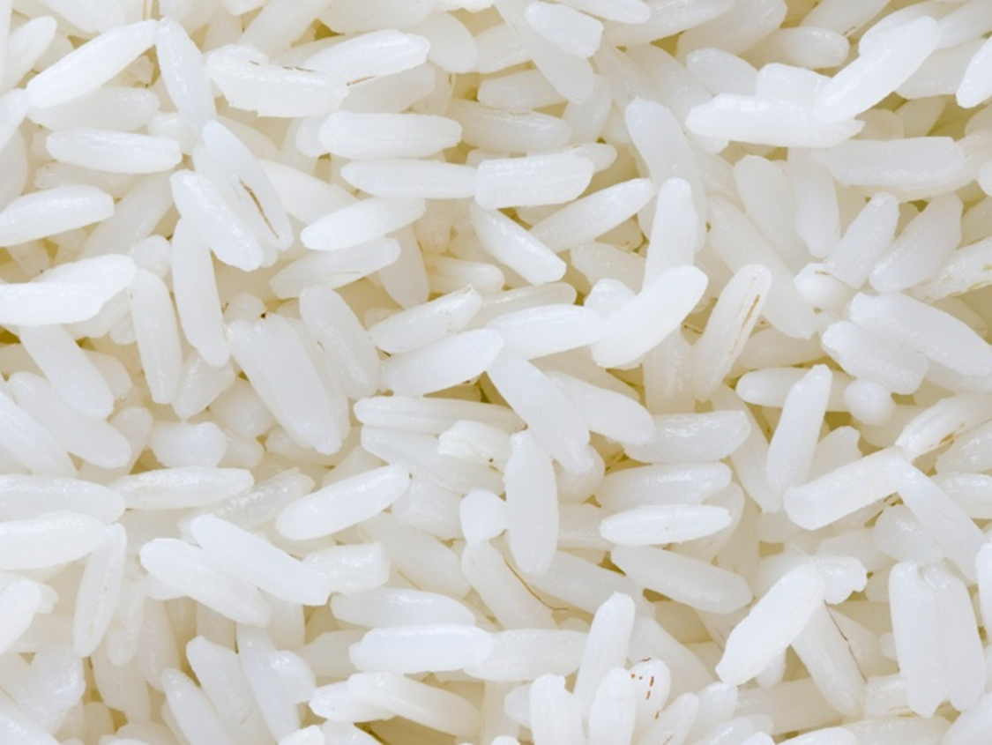
7 days:
127 grains of rice
Notes:
After a week, the inventor still only had a single handful of rice

Slide 6
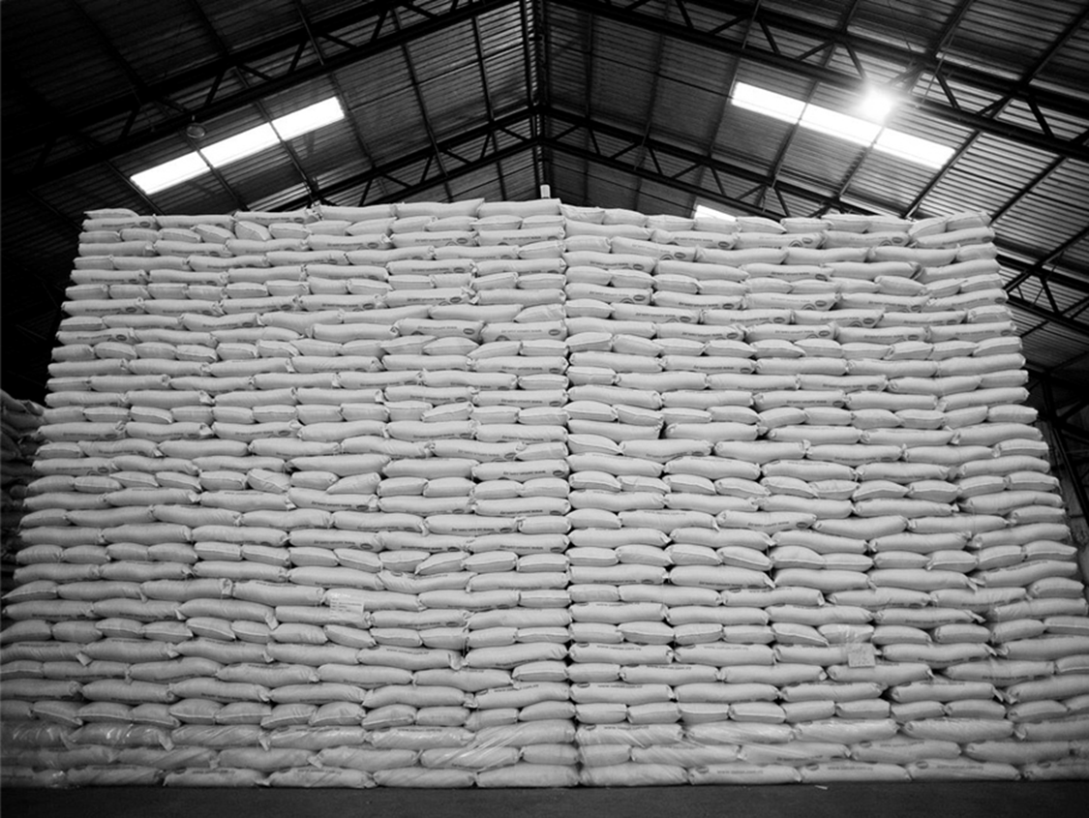
30 days:
2,68,400 bags of rice
Notes:
However, after one month, the inventor had over 2 lakh bags of rice!
And I guess you all already know where I am going with this… right!

Slide 7
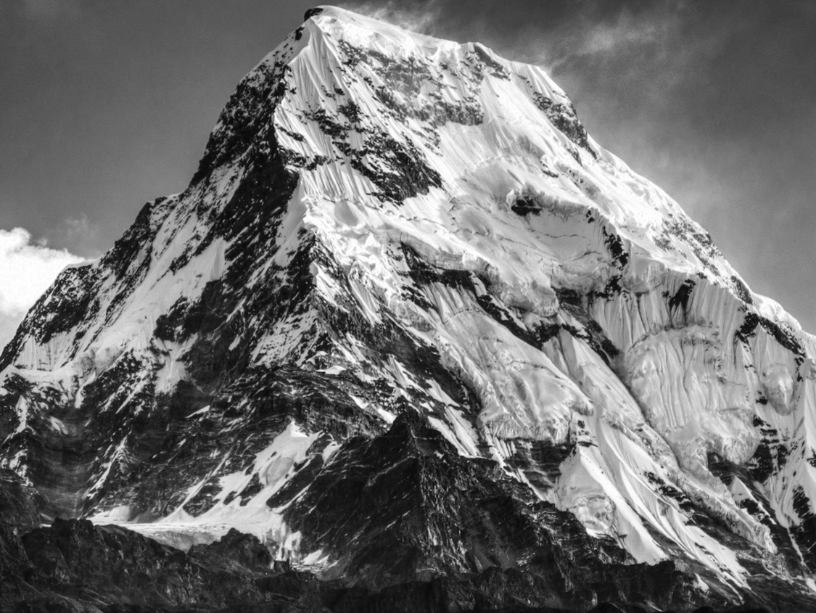
64 days:
461 billion metric tons of rice
Notes:
So after 64 days later, the inventor has a rice pile, the size of a mountain

Slide 8
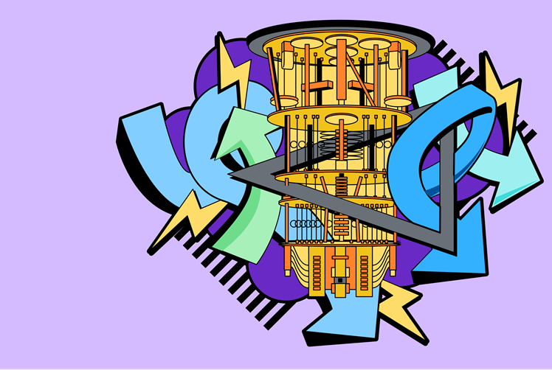
Intro to
Quantum Computing
Vardaan Sahgal
IBM Qiskit Advocate
M.Sc. Physics, NSUT
Notes:
And with the end of this short story, I would like to officially welcome you all to the 1st lecture of Qickstart.

Slide 9
Anybody can learn quantum.
Notes:
Why start a talk about quantum computing by telling you a story about rice?
Strangely enough, both that story and quantum computing share some core principles. Some problems begin very simply, but as you scale them up, they get completely out of control. And the same goes with anything quantum. Things can easily get out of hand if not properly dealt with. This does sound intimidating, BUT
In the Qiskit Community, we believe anyone & everyone can learn about quantum computing.
So I would kindly request everyone to please throw away any preconceived notions you have about quantum, because believe me, this is going to be way more easy and way more fun than you would have expected!

Slide 10
The scale of quantum computing
Notes:
Let’s start with the scale of quantum computing

Slide 11
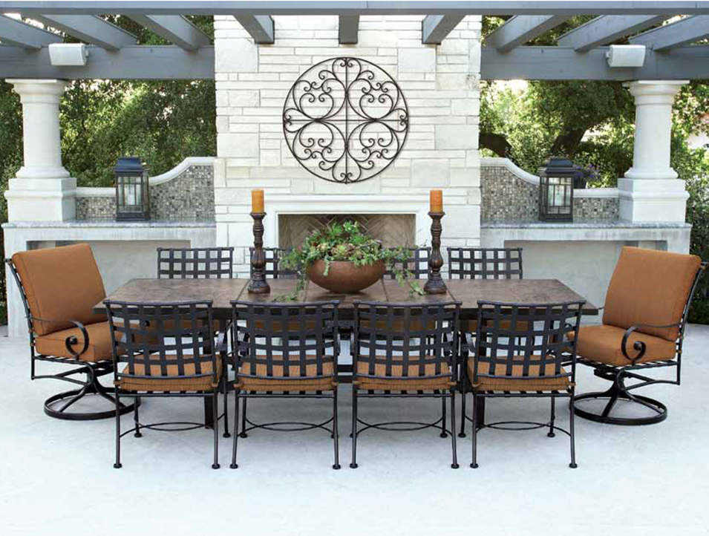
How many ways can I arrange a dinner party of 10 people?
Notes:
Consider a Dinner party, or just a get together with your friends in general
This is a great example of how some problems can grow exponentially large. Although there are only 10 chairs, the way you choose to arrange people can be intensely difficult.
The question is, how many different ways can you arrange those 10 people?

Slide 12
How many ways can I arrange a dinner party of 10 people?
10 Factorial (10 x 9 x 8 x 7 x 6 x 5 x 4 x 3 x 2 x 1)
Notes:
And on the off-chance that you seriously studied that Probabilities chapter in Class 12, you already know that the answer to this is 10 factorial.

Slide 13
How many ways can I arrange a dinner party of 10 people?
10 Factorial (10 x 9 x 8 x 7 x 6 x 5 x 4 x 3 x 2 x 1)
36,28,800 ways
Notes:
Which equates to more than 36 lakh options! And every time you add one more person to the dinner party, this problem grows exponentially.
Very essentially was a simple task, turned into something even our computers struggle to figure out.

Slide 14
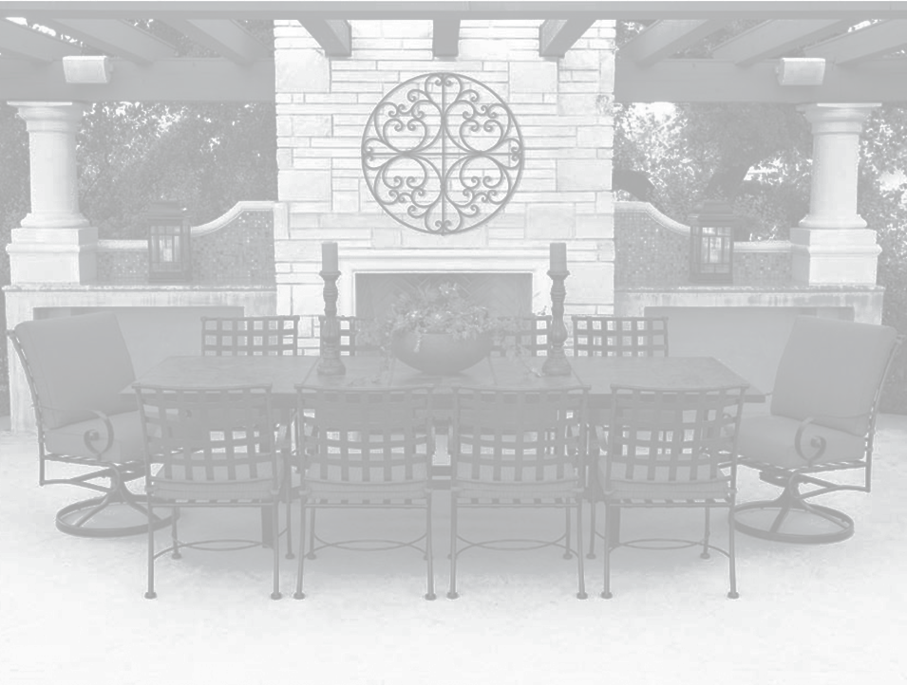
Some problems are bigger than you think.
Notes:
Wait… computers are struggling??

Slide 15
“But don’t we already have really powerful computers that can easily handle big problems?”
- You
(right now, probably)
Notes:
You may be thinking that even though that’s a big number, modern supercomputers are powerful enough to crunch that type of data.
That’s true!

Slide 16
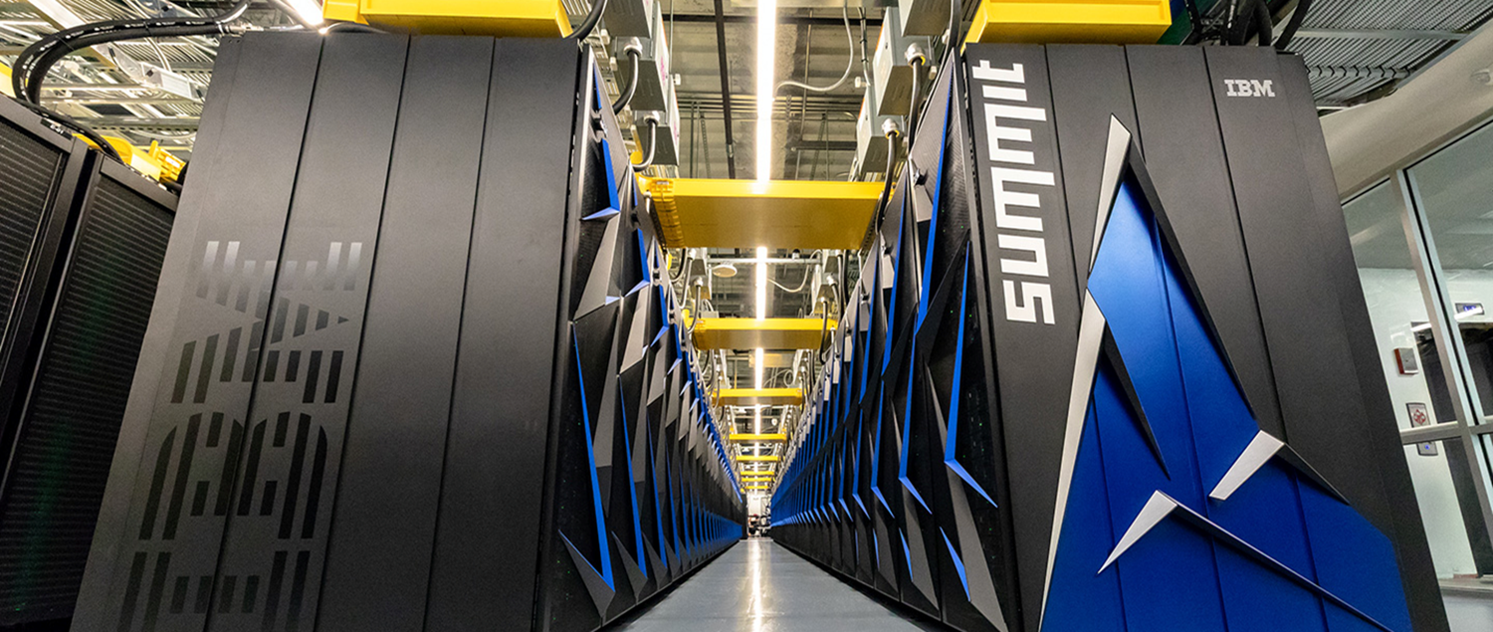
The IBM Summit Supercomputer
Notes:
The IBM Summit Supercomputer has 9,000 IBM Powered CPUs and 27,000 Nvidia GPUs. It is used to simulate viruses, predict weather patterns and natural disasters, and help scientists around the world.

Slide 17

The IBM Summit Supercomputer
250,000,000 GBs
of storage
Notes:
To give you the data, Summit has 250 Petabytes of memory, which is like if I strapped 2 million iPhones together.

Slide 18
The IBM Summit Supercomputer
Which is still not enough to perfectly model…
Notes:
However, even that much storage is not enough to hold all the data and information necessary to perfectly simulate a molecule we all know very well:
And even though I honestly hate chemistry, this molecule is very close to my heart.

Slide 19
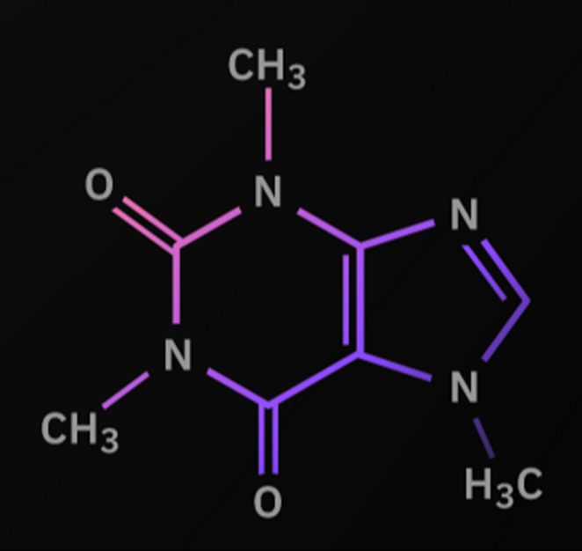
Caffeine
Notes:
Caffeine… now being a coffee lover, ideally I would love to rant and debate to why coffee is better than chai… but for now, I would try restricting to the problem at hand.
Even the Summit supercomputer isn’t powerful enough to completely understand how every bond and electron force interacts with one another, and simulate a caffeine molecule.
Let me give you some stats to prove my point here. It would take approximately 10^48 bits to completely simulate and model a Caffeine molecule. This is far more than the Summit, which has only about 10^16 bits.

Slide 20

Caffeine
Using a classical computer, perfectly modeling all the electrons of a caffeine molecule would require 10⁴⁸ bits of storage. Summit has a fraction of that!
And yet, caffeine exists. Nature has found a way to understand the easiest way to arrange those electrons instantly.
Notes:
And yet, caffeine exists. Thank god!
Nature has found a way to understand the easiest way to arrange those electrons instantly. Nature is an unbelievably powerful calculator, it turns out.
Nature didn’t have to ask a computer how a caffeine molecule should be shaped, how the electrons should interact, etc.
It just makes it happens.
Even though those decisions are so small, they are extremely hard to simulate, and surprisingly even our computers fail here.

Slide 21
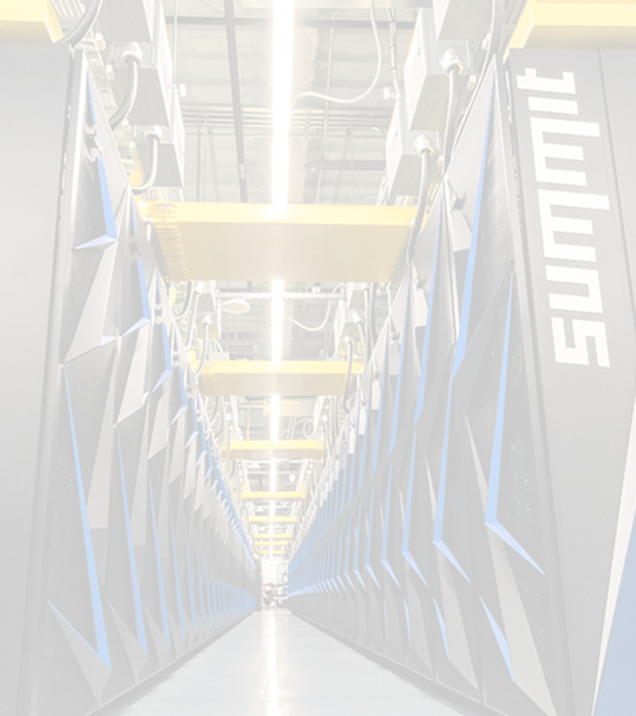
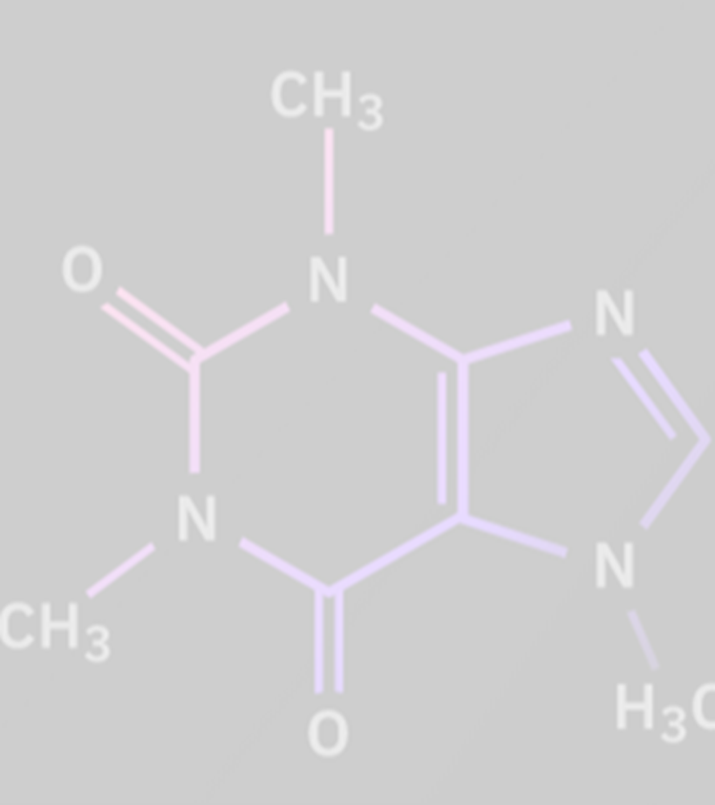
Some problems are too small to see clearly

Slide 22
Big and Small
•This duality of big and small is exactly where quantum computing lives
•Classical computers follow the classical laws of physics.
•Quantum computers follow the laws of quantum mechanics.
•Quantum mechanics = The laws of nature.
»They describes how things behave on a really small scale
»(which is weird!)
Because of this, quantum computers can tackle really big problems much more efficiently than how classical computers can
Notes:
This duality of large and small is exactly where quantum lives. When we talk about “quantum mechanics” we’re really describing the laws of nature at a really small scale. Things like atoms and electrons.
Very small things just behave differently than what humans are used to seeing every day. Sometimes it’s hard to describe!
Nature is able to calculate these decisions instantly, so we decided to harness the laws of nature and use them to our advantage.
Quantum mechanics allows us to approach large problems in new and unique ways. Small and large at the same time.

Slide 23
Why quantum matters
Even though quantum computers are currently limited in certain ways, the potential remains gigantic to create a new paradigm in how we solve problems. Quantum computing provides us:
New algorithms
New approaches to problems
New technological breakthroughs
Notes:
This is where the potential of quantum computers comes in. Scientists think we’re only a few years away from a quantum computer that can perfectly model not only caffeine, but dozens of other molecules for scientists to study.
We think we're close to a quantum computer that can analyze extremely large numbers in minutes instead of hours, or days.

Slide 24
What is a qubit and why is it special?
Notes:
All thanks to qubits, quantum mechanics, and the interesting things they enable us to do!
And this is where I would like to gently ask you guys to take out your pen and paper or whatever you want to take down some notes.
I will briefly introduce some very very very important concepts which will essentially form the basis of everything you will study in Quantum Computing.

Slide 25
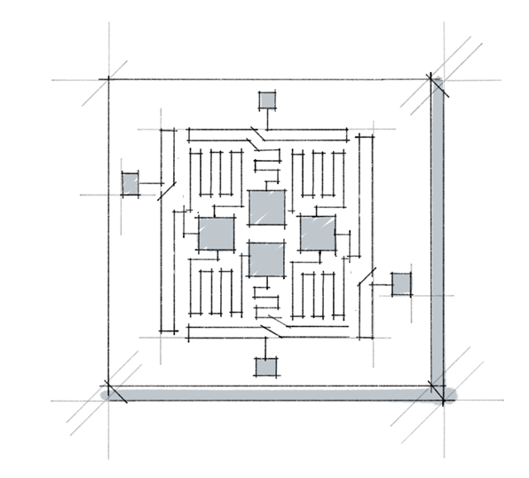
Qubits
The name comes from its description:
A quantum bit of data
Qubits have special properties (we’ll explore next)
There are a few different ways to physically make a qubit.
It’s similar in concept to a bridge – they can be constructed differently, with varying strengths and weaknesses, but they all serve the same purpose
Notes:
We have bits in classical computing.
And in the quantum analog, we have quantum bits… or commonly referred to as Qubits.
Qubits are really awesome, because they show some us pretty interesting properties.

Slide 26

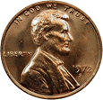

Qubit Property #1: Superposition
Imagine you have 3 coins. When sitting on the table, each can only be in one “state” – heads or tails.
This means when you look at all 3 coins, they can only be in one unique order at any given time. This is how most computers in the world work.
For n coins, we have n possible states
(ex. 8 coins = 8 states)

Slide 27
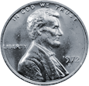


Qubit Property #1: Superposition
Imagine you have 3 coins. When sitting on the table, each can only be in one “state” – heads or tails.
This means when you look at all 3 coins, they can only be in one unique order at any given time. This is how most computers in the world work.
For n coins, we have n possible states
(ex. 8 coins = 8 states)
In the world of quantum mechanics, we can spin the coins. This gives each coin a 50% chance that its state will be Heads, and 50% for Tails.
We call this Superposition, and it allows us to work with far more states at once. It provides an exponential speedup:
For n coins, we have 2^{n} states
(ex. 8 coins = 2⁸ = 256 states)

Slide 28
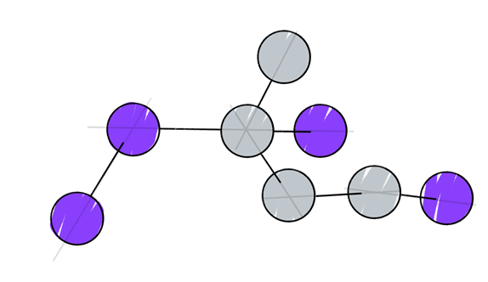
Qubit Property #1: Superposition
Superposition allows us to look at some really big problems, like chemistry simulations and optimization problems, in much more efficient ways thanks to this speedup
Notes:
Every time you add 1 qubit, the total amount of possible states doubles. Same as the lunch problem!
And this allows us to tackle some really hard and challenging problems

Slide 29
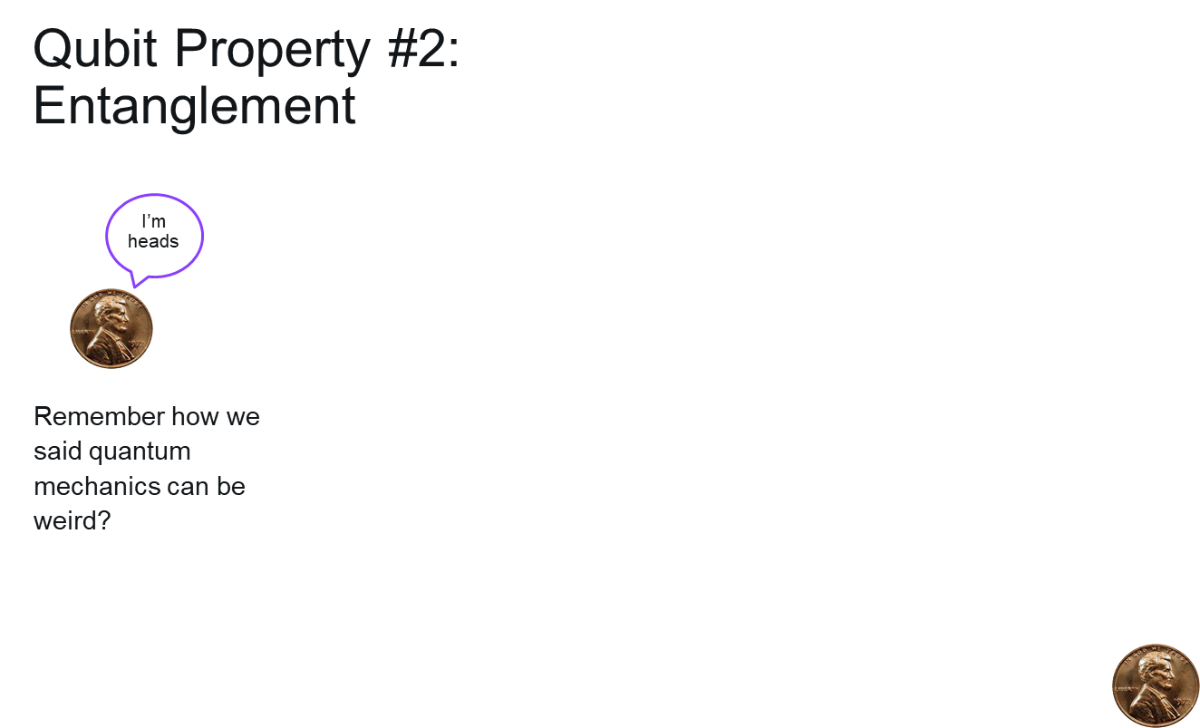
Notes:
Two qubits can become entangled with each other. It’s hard to use our classical understanding to explain what happens here, because this phenomenon is uniquely quantum.

Slide 30
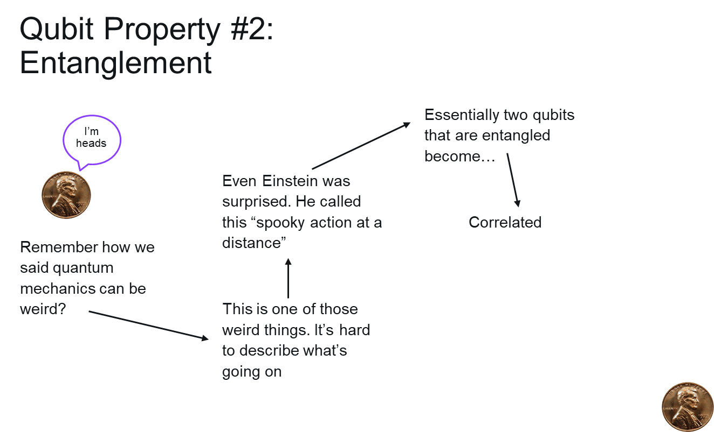
Notes:
Albert Einstein described it as “spooky action at a distance.”

Slide 31
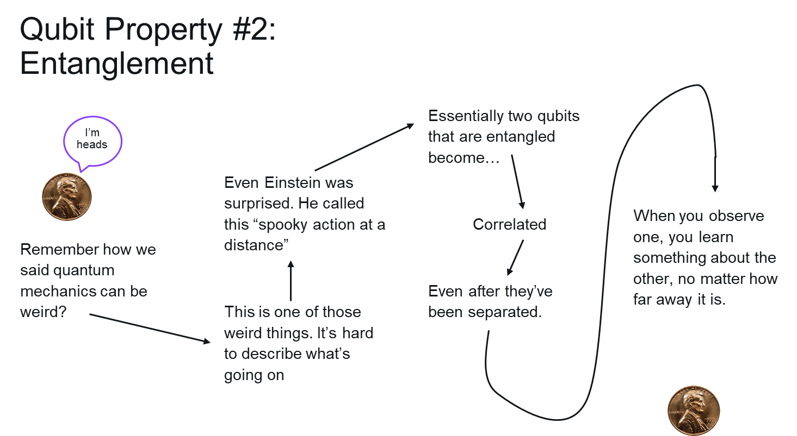
Notes:
Essentially, two qubits that are entangled become correlated, even after those qubits have been separated. When you observe one, you learn something about the other no matter how far away it is.

Slide 32
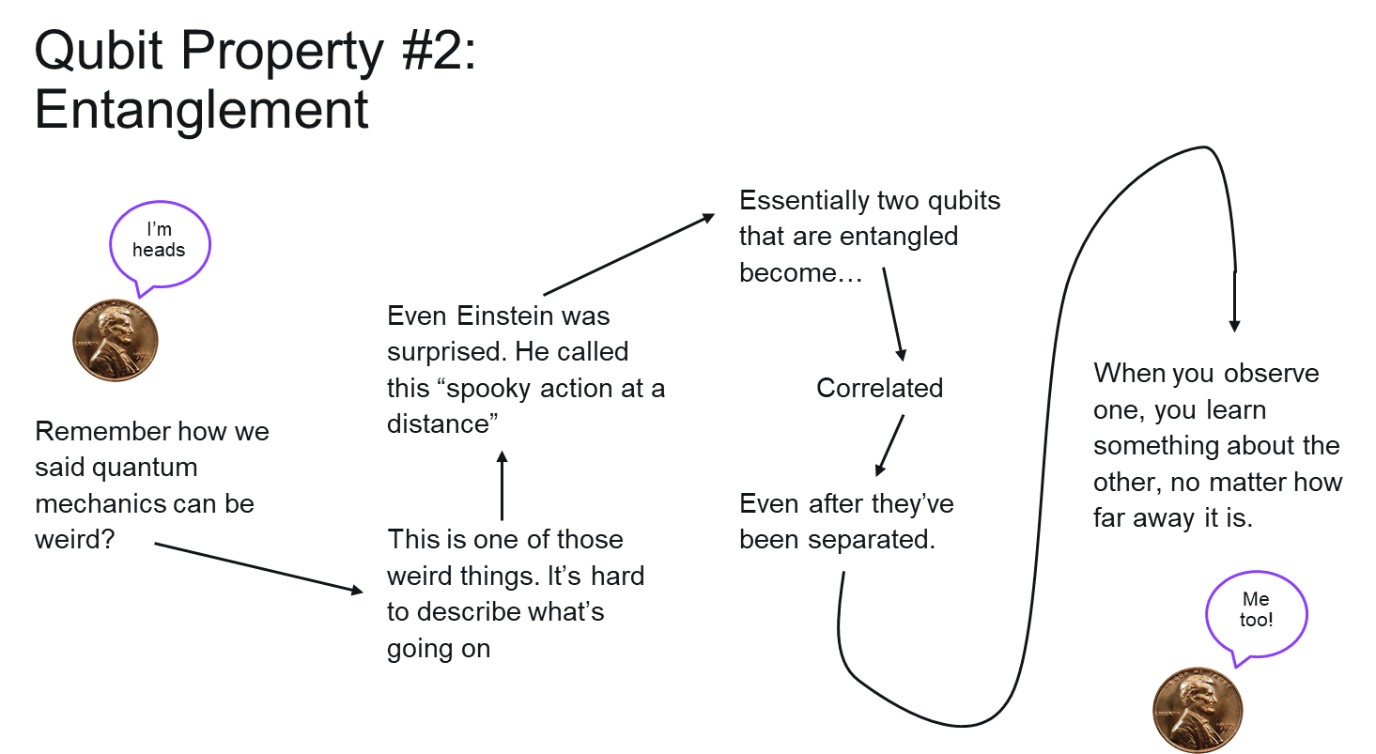
Notes:
For our understanding, it’s only important to know that the qubits in quantum computers can become entangled, and that allows researchers to set up problems in a very different way.

Slide 33

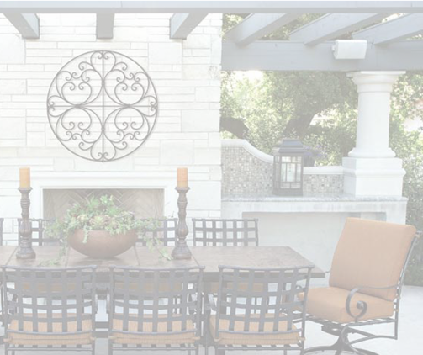
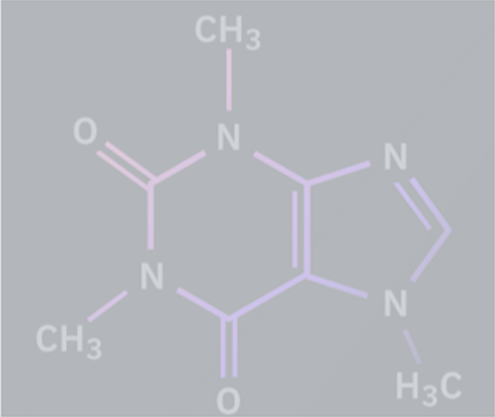
Quantum Computers use special bits of data, called qubits, which follow the laws of quantum mechanics.
We these laws to our advantage, enabling us to put qubits into superposition or to create entanglement.
Using these techniques, quantum computers harness nature to compute problems that are too large for classical computers to solve
Notes:
Here is a brief summary of whatever has been covered till now. I ll like to take a quick breather here. If there are any questions till now, you can ask them now, but please try to keep them extremely short and crisp.

Slide 34
What does a quantum computer look like?
Notes:
Now the question comes, how do you expect me to study quantum when I don’t even know what a quantum computer looks like?

Slide 35
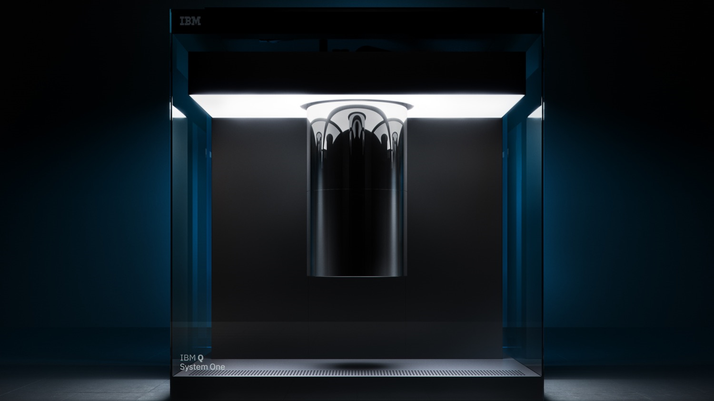
Notes:
This is the IBM System One, a state-of-the-art quantum computer developed by IBM in 2019.
The computer is inside that big shiny cylinder.
Even though it looks futuristic and straight out of a Marvel movie, this is not a gimmick to create hype and in fact each part of this is absolutely necessary for the quantum computer to work.
The shiny cylinder is actually a dilution refrigerator which keeps all the components cooled to the right temperature and shields them from interference.

Slide 36
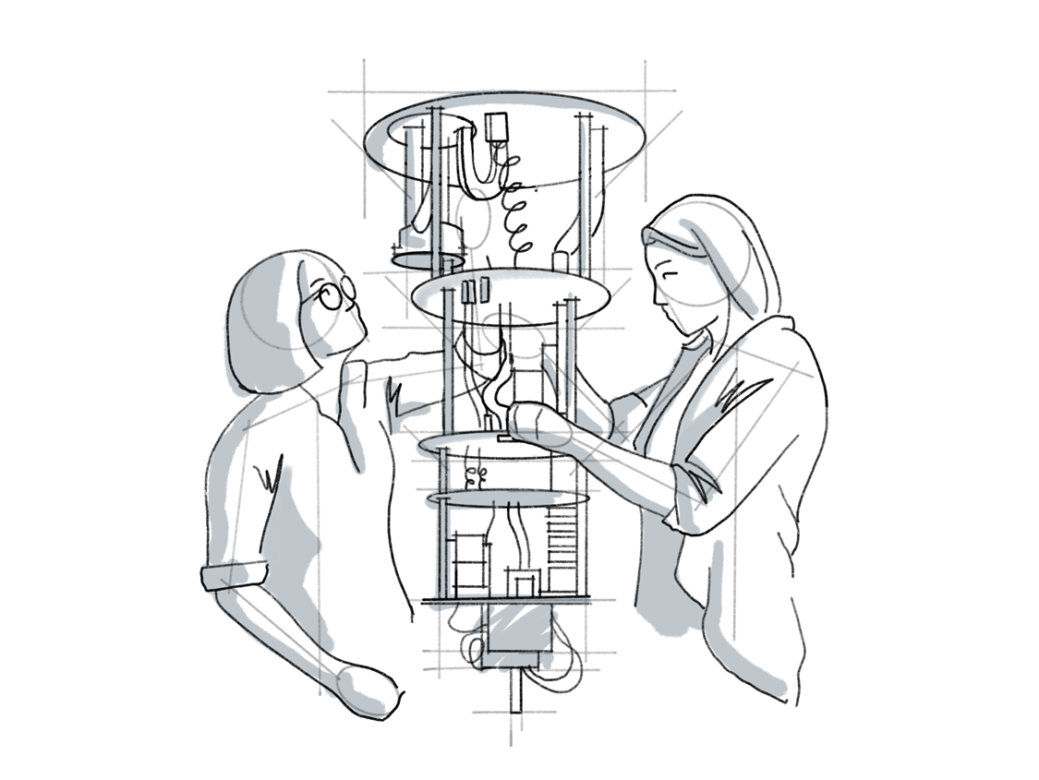
The Chandelier
Quantum computers at IBM look like a big chandelier, full of cables for sending data and maintaining the environment.
Notes:
Inside the shiny cylinder is what we call “the chandelier”, which is composed of the electronics, wiring, and protective elements which allow the quantum computer to function and take commands.

Slide 37
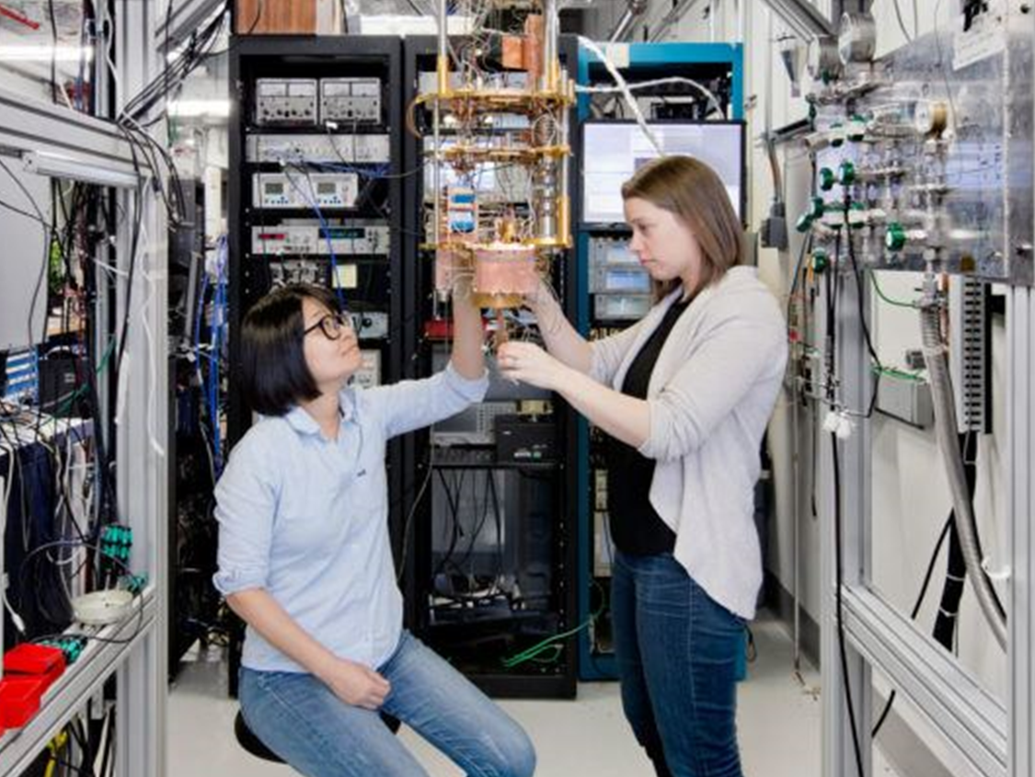
The Chandelier
Quantum computers at IBM look like a big chandelier, full of cables for sending data and maintaining the environment.
Way at the very bottom of this is the quantum processing chip – about the size of a stamp
Notes:
At the very bottom of the chandelier is the actual quantum processing chip, which is about the size of a stamp.
On this chip is where all the qubits live, where all the calculations occur, and where the quantum mechanical “magic” takes place.

Slide 38
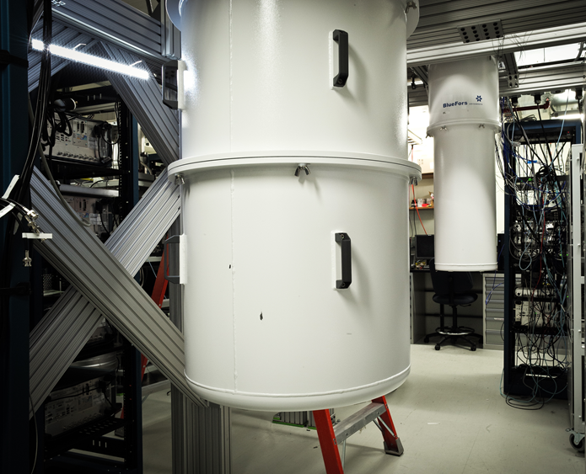
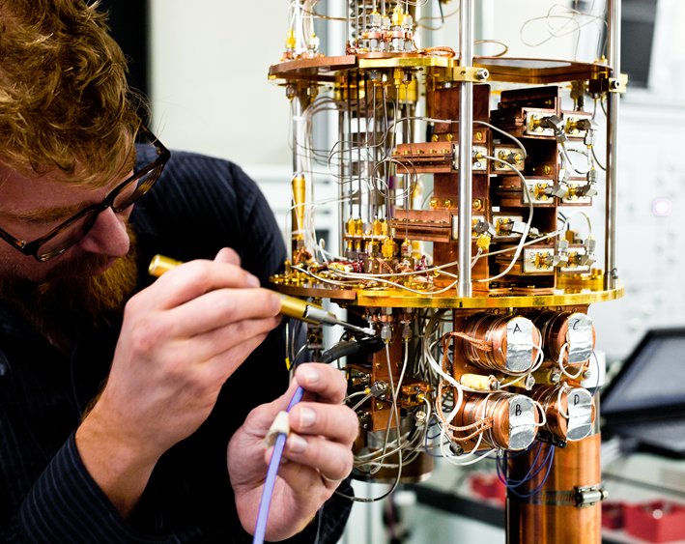
Notes:
Qubits are very fragile, and they don’t like to be annoyed by things like air or light. Scientists had to build a container that would keep all those factors away from the qubits.
Those cables are the microwave coaxial cables that send and receive information from the qubits.
The white cylinders are other devices, either being built or operated behind the scenes, and feature layers of shielding that protect the quantum processor from any radiation
We use an electronics rack (not pictured) that sends signals in and out, via microwave pulses. More on that in a bit.

Slide 39
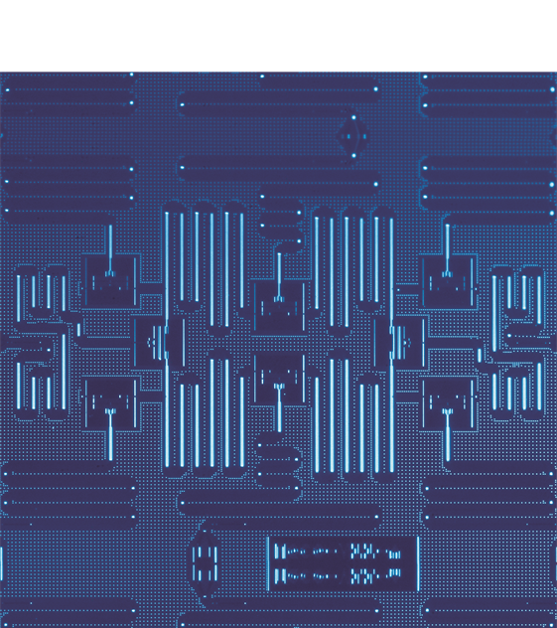
The processing chip
Zoomed in, you can see the different parts of the chip itself
•The dark blue squares are the qubits – our quantum pennies!
•The squiggly lines are microwave resonators which is how our pennies talk to each other, and the computer sending it instructions
•To work properly, this needs to be cold. Colder than outer space: 0.015 kelvin!
Notes:
Delicate nature of qubits!
Only for superconducting qubits

Slide 40
What are quantum computers used for?
Notes:
Only one more question to answer before I wrap up the presentation.
Why should I study QC? How will it benefit me?

Slide 41
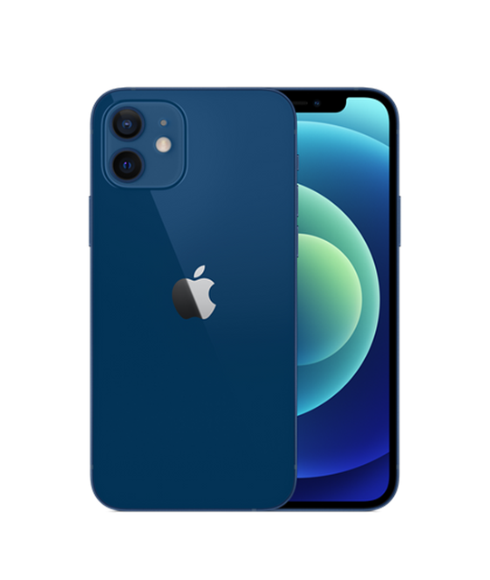
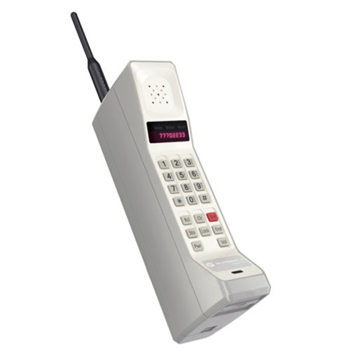
Near vs. Far
Picture: https://www.everything47.com/design/motorola-dynatac-800x/
Picture: www.apple.com
Notes:
Cell phones these days can do a lot more than take calls. You can text a friend, take a picture, read news from around the world, watch videos of anything you can think of, invest in the stock market, order a car to pick you up, send someone money,, book a trip to Hawaii, and buy a new pair of Jordan 1’s (as long as the SNKRS app doesn’t crash again). They’re pretty magical devices.
If you think of quantum computing as a timeline, we’re much closer to the Motorola Dynatac than we are to the iPhone. In quantum, we use the phrase “near term” and “far term” to talk about these two different timelines.
“Near term” results on a quantum computer are like what we achieved with cell phones in the 1990’s. Progress - but definitely not at their possible future yet.
“Far term” results are like what smartphones have enabled today. A profound advancement not just in cell phones, but in how people live and work in the modern world.

Slide 42

Notes:
IBM has already talked about its plans for the near term, which include creating more reliable devices that have thousands of qubits, while also making the software more approachable. This near term hardware future is what we think will allow scientists to model the caffeine molecule I mentioned earlier.
But you might be asking yourself “what else can these expensive computers do?”

Slide 43
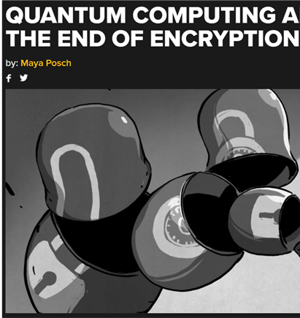
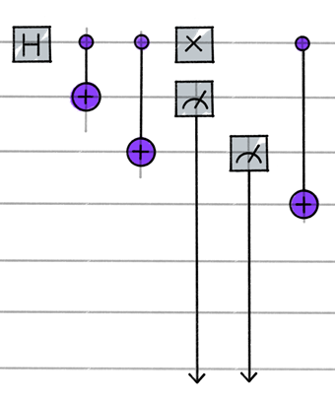
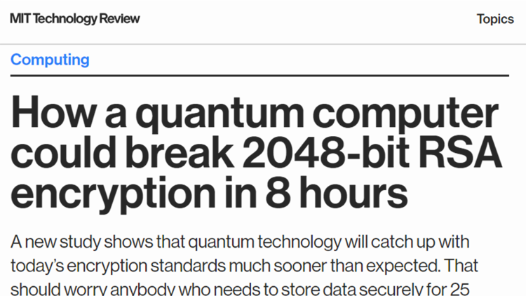
Break Encryption
A perfect quantum computer, using code called Shor’s Algorithm, could crack today’s encryption.
iMessage? Hacked.
Secret databases? Hacked.
Government secrets? Hacked.
Notes:
You may have heard in the news about how quantum computers could break encryption and see all the world’s secrets. Encryption is used to hide sensitive information, and

Slide 44
Break Encryption
A perfect quantum computer, using code called Shor’s Algorithm, could crack today’s encryption.
iMessage? Hacked.
Secret databases? Hacked.
Government secrets? Hacked.
eports of encryption’s death are greatly exaggerated. This is a far term application of quantum computers. It’s decades away.
Notes:
The good news is, this is a FAR TERM application for quantum computers. The devices today are not nearly powerful enough to accomplish this type of bad behavior, and we think it will take decades before they are.
Companies that provide encryption are already hard at work on creating a new, quantum-safe protocol for how to encrypt data in the future. This is not something to worry about.

Slide 45
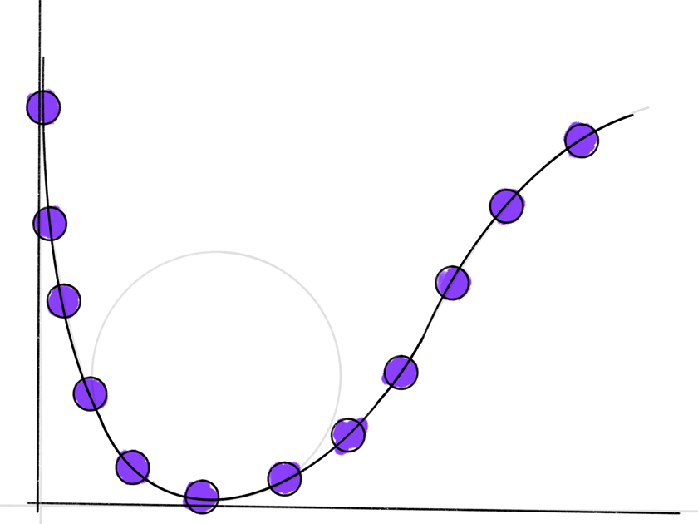
Chemistry
Using an algorithm called “VQE” we’ve already gotten scientific results using quantum computers analyzing different molecules
Notes:
Chemistry can be described both as a near-term and far-term goal of quantum computing. Scientists already have real world results from some chemistry research that was enabled by IBM’s quantum hardware. In the future, the hope is to use this type of computing to understand nature in a much more powerful way.
As mentioned earlier, we think fully modeling a caffeine molecule is in the near-term. Fully modeling something like a piece of your DNA or other large molecules is a far-term goal.

Slide 46
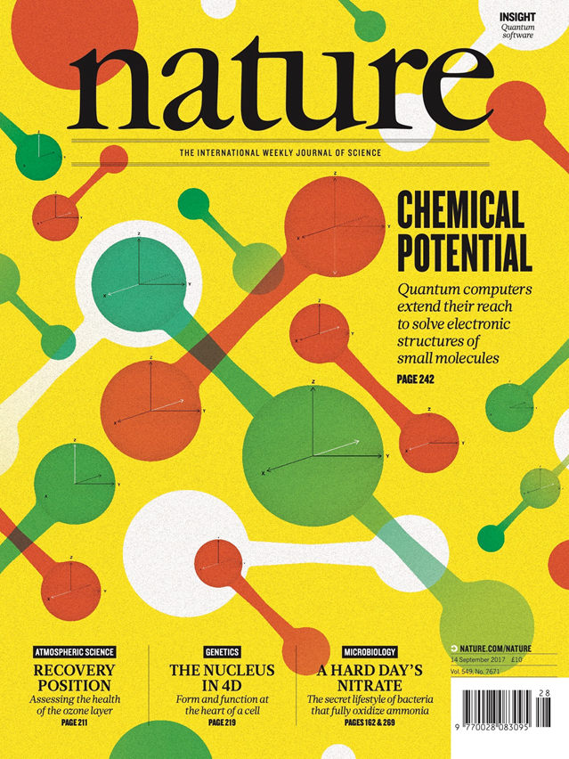
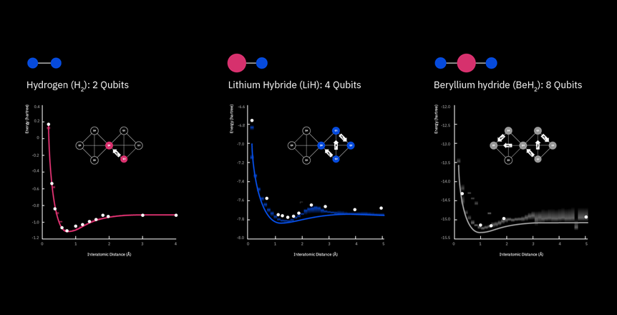
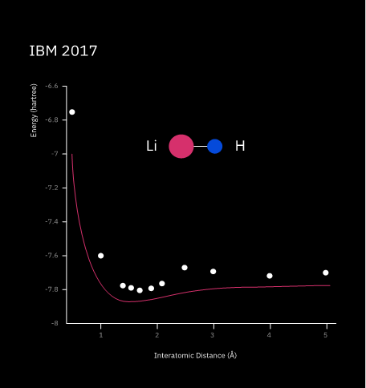
Notes:
Here’s one of the chemistry experiments that made the cover of Nature magazine. IBM scientists used a quantum computer to simulate the molecule Lithium Hydride. Then, one year after the initial findings, they were able to find a 10x improvement in fidelity using the exact same hardware, just by finding a new error mitigation techniques and applying them in the code they used.
Advancing the field of quantum computing is both a hardware and software problem.

Slide 47
What if you are not a scientist?

Slide 48
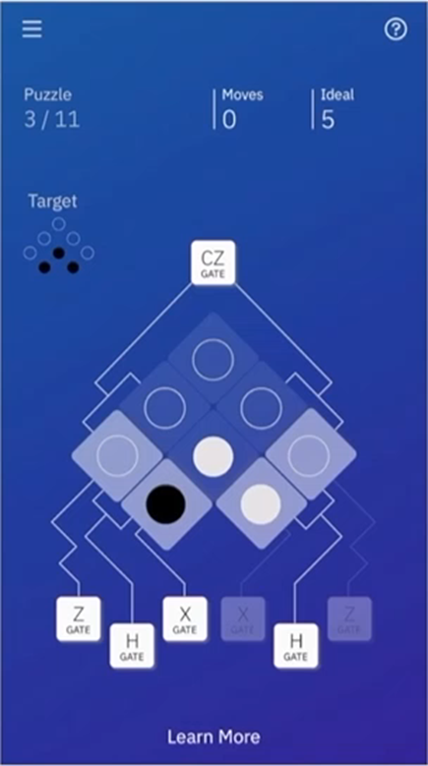
Quantum Games
One way quantum computers are already being used is for games! Both educational games and games that use quantum computers for generation of the game’s assets.
Search for “Hello Quantum” on iOS and Google Play

Slide 49
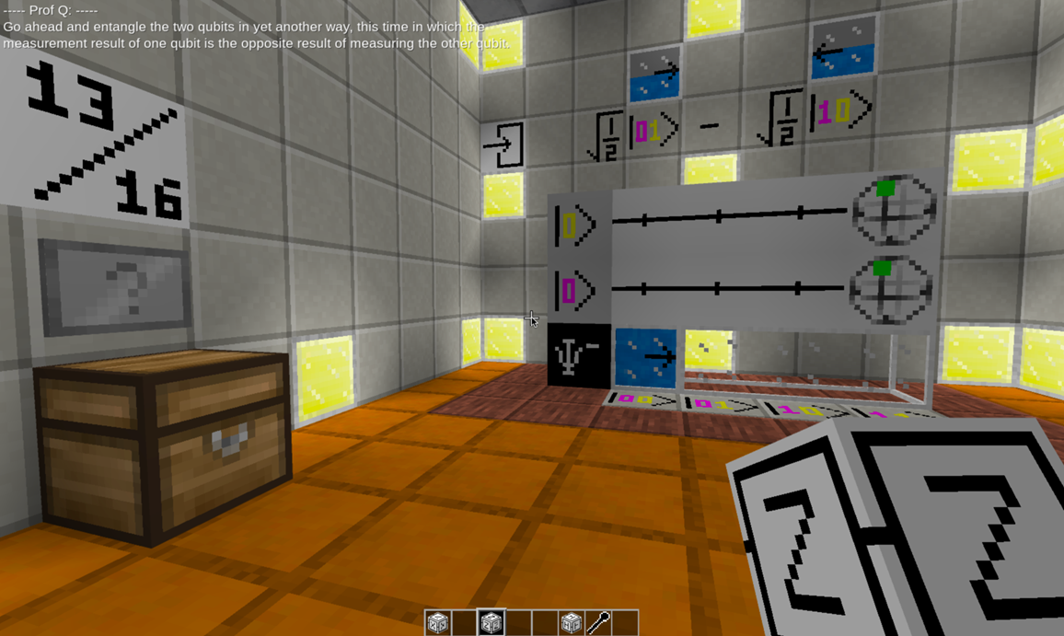
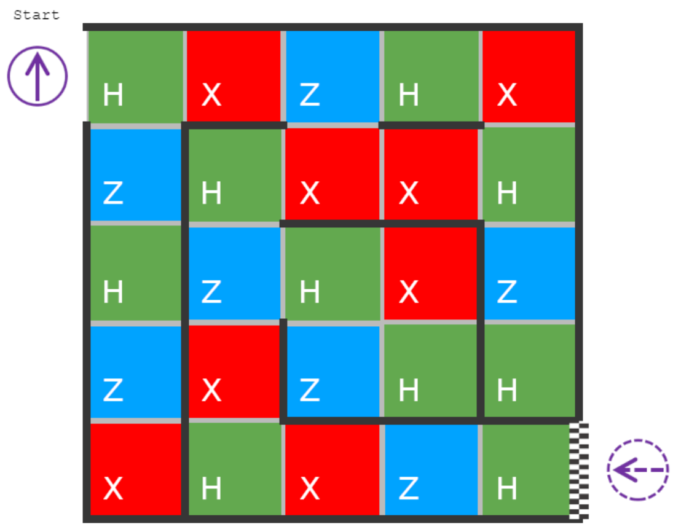
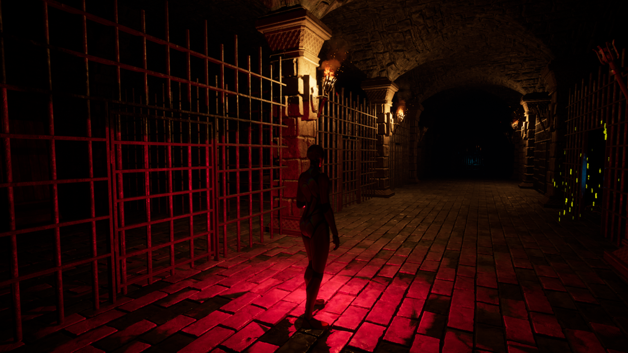
Qiskit Blocks
Minecraft-esque game to learn the basics of manipulating a qubit
https://qisk.it/blocks
Quaze
A quantum twist to the classic game of Maze
https://qorsairs.github.io/Quaze
Entangled Souls
A story‑driven 3D quantum - puzzle room video game with a horror theme
https://quantumgames.aalto.fi/game-entangled-souls/
Notes:
And here I would take a moment to shamelessly promote a few of the quantum game which I have created.

Slide 50
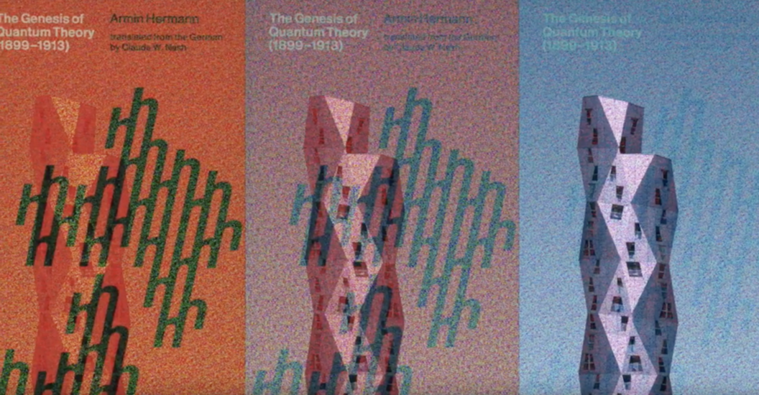
Art
The world’s first Quantum Art and Design Jam happened in 2021 in NYC, a collaboration between IBM and The New School
Notes:
Every medium is a form of technology that enables artists to do new things. These affordances are different for each medium. For example, photography affords artists the ability to capture a moment in time in a way that watercolor cannot. However, watercolor has a gestural quality that generally can’t be replicated by a medium like photography.
Computers have been made with the same fundamental principles since the early to mid twentieth century. However, quantum computing is like starting over and inventing the computer again from scratch, now powered via quantum mechanics to do computations instead of the standard classical principles most computers use today. By reinventing the computer to leverage quantum mechanical properties, a new set of affordances is introduced to power these computers, and these affordances can be exploited for creative purposes.

Slide 51
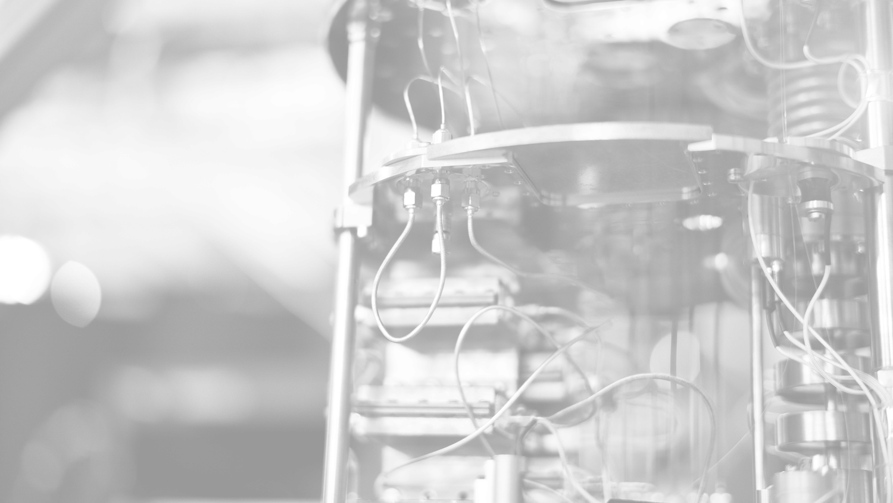
For most of history,
to access to a quantum computer,
you had to build and maintain it yourself.
Notes:
Initially accessing a quantum computer was extremely difficult

Slide 52
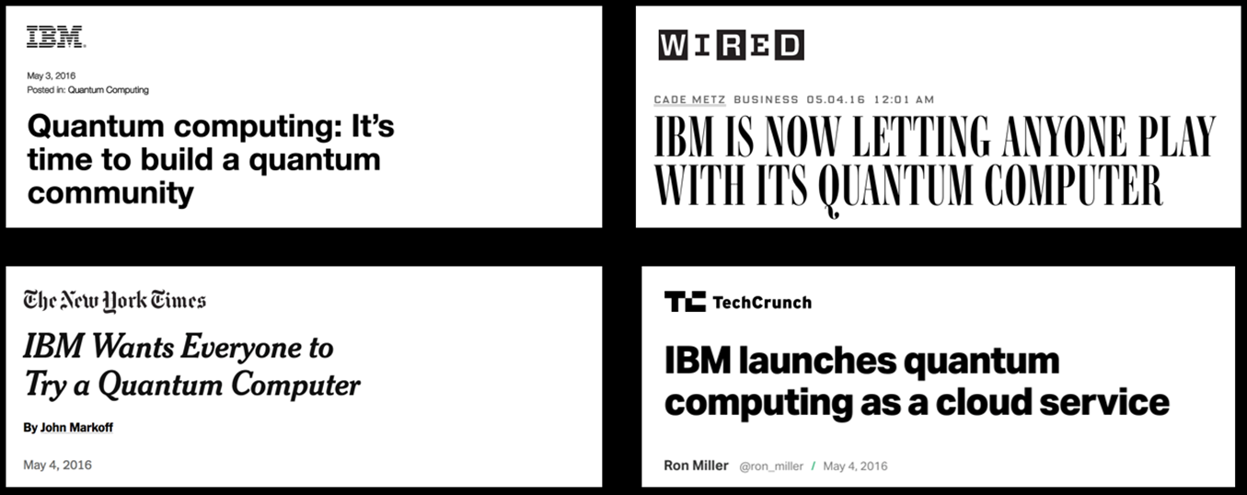
In 2016, that changed.
Notes:
And in 2016, IBM changed everything. They made Qc available on the cloud and accessible to everyone
And finally I would like to end this presentation and leave you guys with a formal introduction to qiskit… something we will be talking a lot about in the coming few days!

Slide 53


Slide 54
Notes:
Thank you everyone

